Slide 1
Watson AI Platform Overview

Slide 2
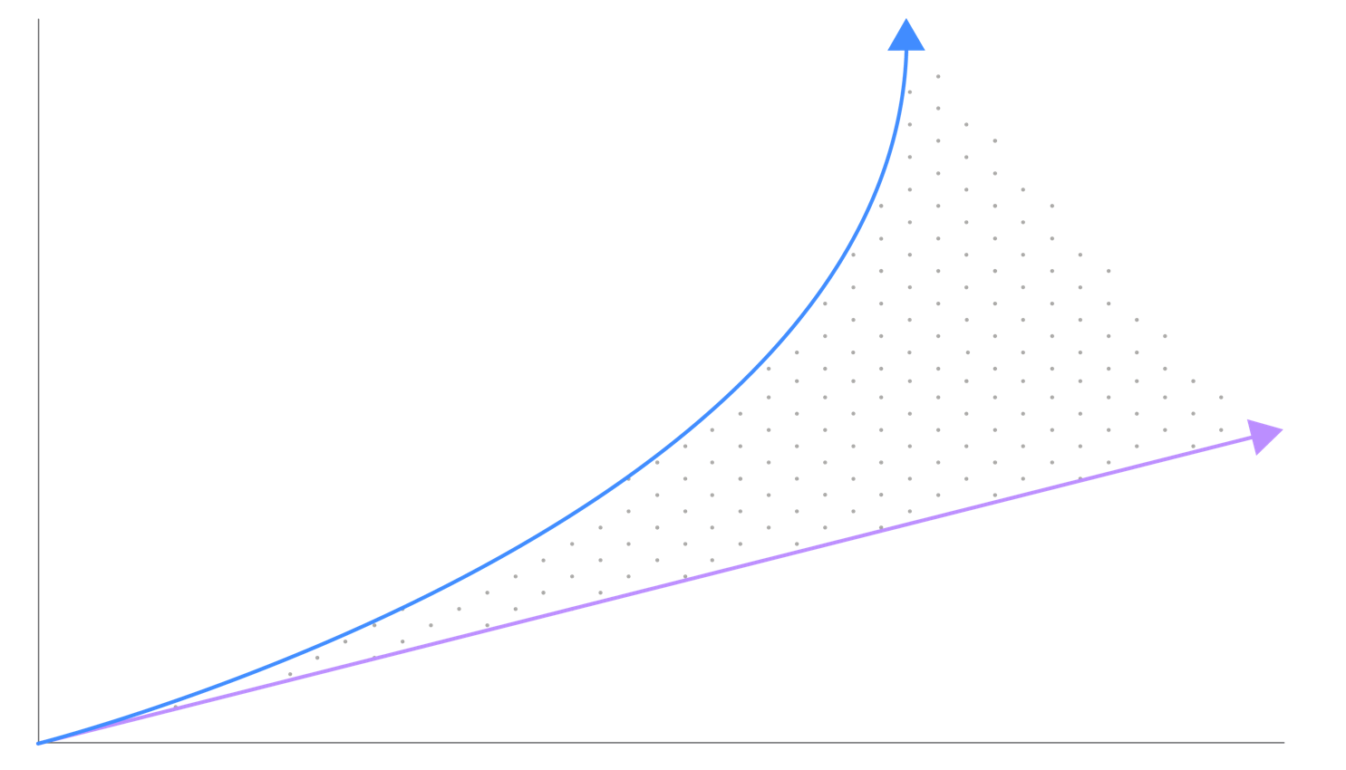
As the volume of data, digital transformation, and the pace of technological change accelerate, the ability of organizations and professionals to keep up and capitalize on the opportunity is becoming more challenging.
Data proliferation
RATE
Capacity and ability to adapt
TIME
© 2018 IBM Corporation
2

Slide 3
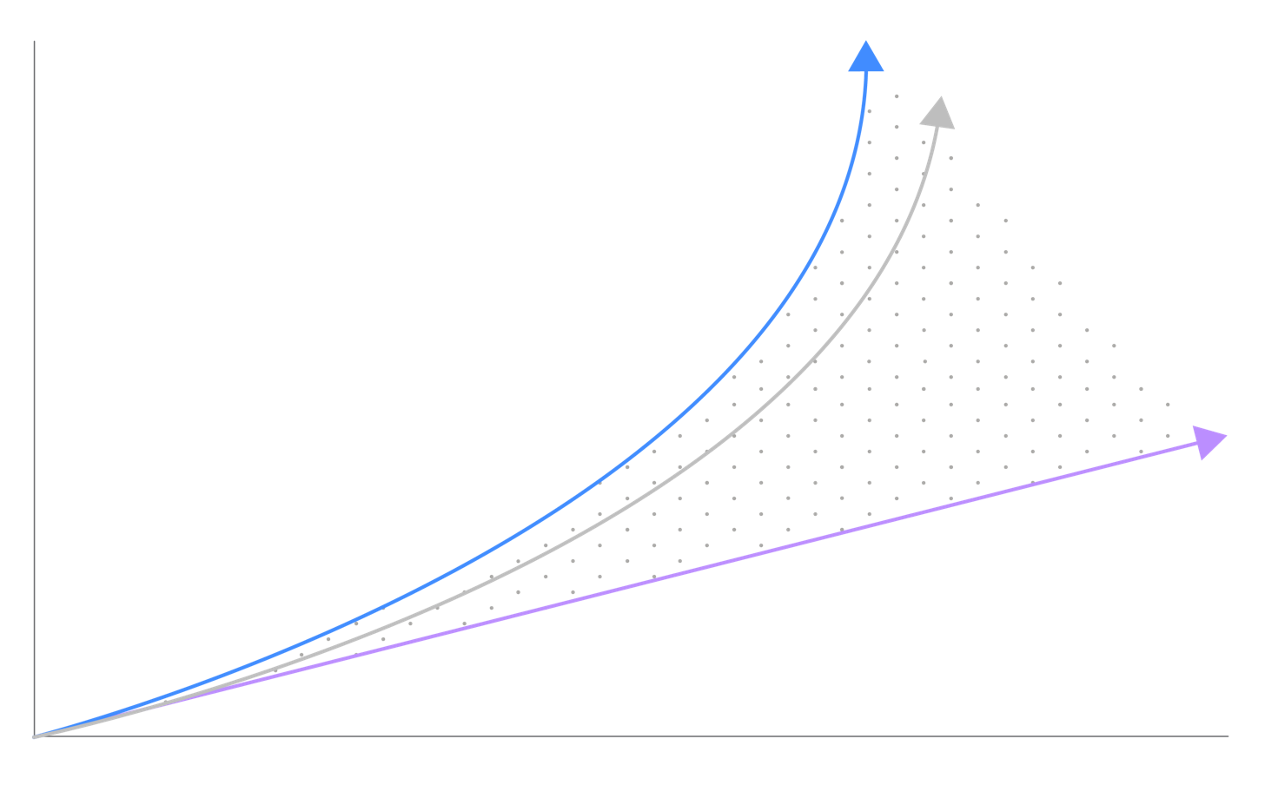
As the volume of data, digital transformation, and the pace of technological change accelerate, the ability of organizations and professionals to keep up and capitalize on the opportunity is becoming more challenging. AI provides an opportunity to help professionals close the gap and harness the full potential of data by creating new tools to improve their work and outcomes.
Data proliferation
Knowledge and capability
RATE
Capacity and ability to adapt
TIME
© 2018 IBM Corporation

Slide 4

In 2018, blended AI will disrupt your customer service and sales strategy
85% of CIOs will be piloting AI programs by 2020
Knowledge workers spend 80% of their time searching and preparing data... NOT on innovating with Data Science and AI
75% of commercial enterprise apps will use AI by 2020
Notes:
2017 IDC report: http://idcdocserv.com/US42072917e_IBM

Slide 5
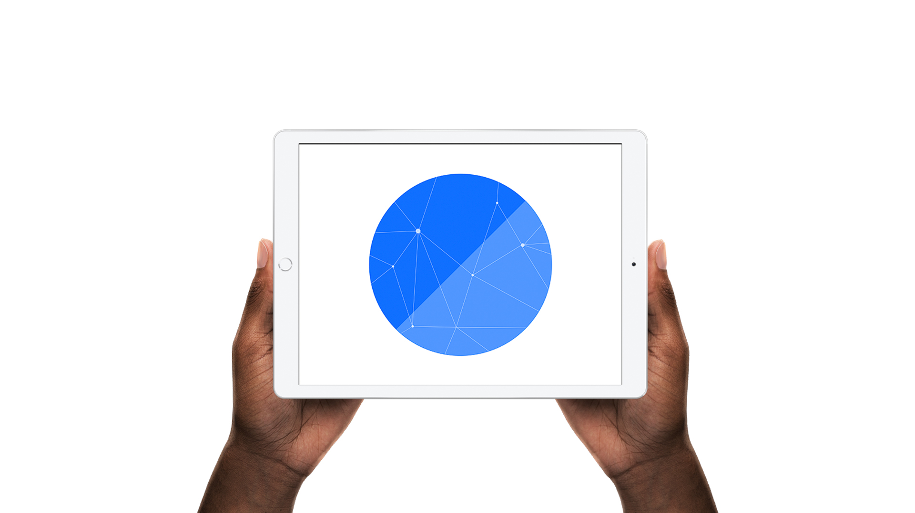
Watson is creating a new partnership between humans and technology
Humans excel at
Cognitive Systems
excel at
COMMON SENSE (with biases)
LOCATING KNOWLEDGE
MORALS
IMAGINATION
NATURAL LANGUAGE
COMPASSION
PATTERN IDENTIFICATION
DILEMMAS
MACHINE LEARNING
ABSTRACTION
ELIMINATING BIASES
DREAMING
PROVIDING ENDLESS CAPACITY
GENERALIZATION
© 2018 IBM Corporation
5
Notes:
Humans are inherently capable of a set of skills that help us learn, discover and make decisions:
We can apply common sense, morals, and reason through dilemmas; we can dream up new ideas and make generalizations when essential clues and pieces of information are missing.
But we’re restricted by the time it takes to learn, process, and absorb new information and limited by the unconscious biases we all possess that influence the decisions we make.

Slide 6
Four capabilities distinguish Watson from traditional programmed computing systems
Understand Watson understands like humans do.
Reason Watson reasons. It understands underlying ideas and concepts. It forms hypotheses. It infers and extracts concepts.
Learn Watson never stops learning, getting more valuable with time. Advancing with each new piece of information, interaction and outcome, it develops “expertise.”
Interact With abilities to see, talk and hear, Watson interacts with humans in a natural way.
© 2018 IBM Corporation
Notes:
Understand: Two key attributes define understand. First, the ability of a system to navigate the complexities of human speech– understanding the idiosyncrasies, colloquialisms and knowing the ways we would express ourselves to one another. This is not an easy task. We say things like, “This morning I got a haircut.” This could reference the barbershop, OR a bad financial trade. The second attribute is being able to put content into context- not search and keyword– but actually bringing forward relevant, actionable content.
Reason: There are very few times where we, as humans, are presented with information that is useful WITHOUT having to infer from the data to extract what we need for our purposes. In doing so, we are reasoning with a purpose– often generating a hypothesis and then proving out the theory. This is something cognitive systems, like Watson, can do.
Learn: Cognitive systems are fundamentally different from traditional computational computers, which are hard coded with rules and logic, following a decision tree format. Cognitive systems get progressively smarter with each outcome, action, iteration– with each new peace of information.
Interact: With abilities to see, talk and hear, cognitive systems interact with humans in a natural way.

Slide 7



Watson Differentiators
Protects your insights
Learns more with less data
Reimagines your workflows
Customers develop and own insights with enterprise data and models
Customization capabilities for specific domains and private enterprise data
EU Model Clauses, ISO and PII* compliant; GDPR in 1H 2018
Industry leading capabilities to learn from small data
Compare & Comply for understanding governing documents
Pre-trained smarts out of the box
Enterprise grade full stack AI
IBM Cloud Private support, starting with packaged use cases
Single Data & AI Watson Studio is unique in the industry
© 2018 IBM Corporation
Notes:
Watson is the AI platform for business with the broadest reach– reaching over 1 billion users and consumers
***Bringing Watson to the world through new B2B2C experiences: Watson Assistant brings you the tools and solutions to implement an AI assistant built for business– one that helps companies deliver highly personalized and engaging branded experiences, reaching millions of consumers
Broadest array of ISVs and partners are embedding Watson, putting AI in hands of professionals
***IBM + Apple: IBM and Apple will partner to bring Watson to Core ML on IoS, giving clients the ability to create custom visual models that run through Core ML on iOS devices
***Pre-trained content and solutions enable clients to start quickly with offerings that have out of the box expertise
IBM Watson Data Kits enable developers to cut training time with pre-trained, pre-enriched content. A new Watson business solution comes pre-trained on customer complaint data
Watson Assistant is pre-trained in four domains prebuilt content which comprises common customer service and industry intents that Watson has been trained on out of the box
3. Watson is making AI easy to use– with the most accessible platform and tools for bringing AI and Data together
***Watson Studio and Watson Knowledge Catalog make it easy to build, deploy, train and manage AI, ML and DL models at scale: IBM is taking its managed, self-service Data and AI platform to a new level with Watson Studio, which gives data scientists, developers and business analysts the ability to build and train AI, ML and DL models, visually design neural networks using the most popular frameworks, and work with structured, semi-structured and unstructured data.

Slide 8
Watson AI Platform Offerings: Watson Assistant (Formerly IBM Watson Conversation and IBM Watson Virtual Agent)
© 2018 IBM Corporation

Slide 9






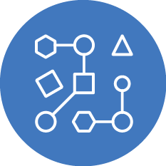
Watson Assistant allows businesses to improve how end-users engage
Build once, deploy across multiple platforms
Create natural language interactions to better serve your end-users
Get started quickly with pre-built content
Create an omni-channel experience for better user engagement
Walk customers through business processes like application forms or resetting a password
Leverage machine learning approaches to improve the conversational model
© 2018 IBM Corporation
Notes:
For LOB and developers that want to BUILD a chat bot or virtual assistant.
UI driven dialog builder allows SME’s the ability to easily construct dialog flows for bots
Leverages advanced cognitive & machine learning algorithms to understand the intent of user
Start Fast. Start Free
Includes
SDKs with code samples to jumpstart deployments
Access to a broad set of platform services to augment conversational use cases (e.g., Speech, Tone, Discovery)
Enterprise support with the Premium Plan (data isolation, e2e encryption, PII support)

Slide 10
IBM Watson Assistant
IBM Watson Assistant portfolio
IBM Watson Assistant Solutions
Custom Solutions
Hospitality
Automotive
1. Comes pre-trained
2. Understands & remembers
3. Recommends
4. Protects your data
© 2018 IBM Corporation
Notes:
We are introducing the IBM Watson Assistant portfolio. The portfolio is built on IBM Watson Assistant which is the latest evolution of our AI assistant technology. This foundational solution addresses four key areas:
Watson comes pre-trained on customer care and industry specific content… increasing time to value.
Watson remembers and understands. When your customer changes the subject mid-conversation, Watson recognizes the new intent -answers their question- and then understands to come back to the original subject.
Watson recommends. Watson takes your customers questions and recommends updates. This helps your teams improve your bot faster.
Watson protects your data. Watson is built with enterprise security, data privacy and data isolation. Your data and insights are yours. And yours alone.And we know you need industry focused assistants that connect seamlessly through your business into your products and services. To meet this demand, we’ve created IBM Watson Assistant Solutions focused on industries such as hospitality and automotive. The solutions extend the foundation functionality with industry-specific AI capabilities.This is an AI assistant focused on your brand, your customer and your data.If you're looking to improve customer service - now is the time to embrace AI.

Slide 11
Key differentiators
Simplified tooling – allows collaboration between business users and developers to build out conversational solutions and advanced dialog flows, without needing to be an expert in Machine Learning.
Premium/Dedicated Plans – provide enterprise-grade security and support, such as data isolation, end to end encryption, and support for non-regulated PII data.
Deep industry expertise and partnerships – e.g., health, banking, automotive, retail
Data Control – clients maintain control and ownership of their data
IBM and Royal Bank of Scotland Assist were awarded
Best Cloud Project at 2017 Cloud Excellence Awards
© 2018 IBM Corporation

Slide 12
Watson AI Platform Offerings: Watson Discovery Portfolio Watson Discovery Service Watson Natural Language Understanding Watson knowledge Studio
© 2018 IBM Corporation

Slide 13
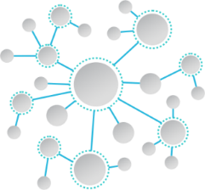
Watson Discovery Portfolio
Unlock hidden value in data to find answers, monitor trends, detect anomalies, and surface patterns with the world’s most advanced cloud native insight engine.

Slide 14
Watson Discovery Service extends functionality to allow for cognitive search and content analytics capabilities to be combined into new and existing applications.
Discovery News Service
Watson Knowledge Studio
News trending, alerts, event detection and search
Train Watson to add domain customization
Watson
Discovery Service
Rapidly build a cognitive search and content analytics engine
Notes:
Watson Discovery ingests unstructured data and enriches it with Watson Natural Language Understanding algorithms, then indexes the data into a high-performance search backend, enabling large datasets to be queried and explored with the power of Watson’s cognitive technology.
Discovery addresses key developer pain points …
Speeds the time it takes to extract, transform and load data from diverse and disconnected sources, including chat logs, emails, nps scores, support tickets, news and social media … and then query and manage constant updates
Stretches IT budgets and resources
In many cases, developers can prototype a solution in as quickly as a day to begin finding insights.
Combine and query other data sources from within the organization or from public sources to extract complex insights.
Discovery eliminates infrastructure and scale challenges so you can jump right into solving your particular business problem.

Slide 15

The Two Sides of an Insight Engine
Document Centric
Knowledge Centric
Reasoning strategies to retrieve a document or passage with the answer…
Reasoning over connections of semantic understanding
(entities, relations, concepts, etc.) leading to insights…
“What does all-risks insurance of an automobile contract cover?”
“What are the most popular policies for newly married couples?”
“What are the typical complaints regarding customer wait times?”
“How do I insure a furnished house?”
“How do I insure a replacement vehicle when my main vehicle is being repaired?”
“What are customers saying about the conditions of our branch offices?”

Slide 16
Discovery Applications (examples)
Know the Voice of Your Customer
Understand what matters to your customers with an AI-powered application that can consolidate and discover new insights from customer feedback. Identify patterns and trends, surface new product needs, catch product failures early and more often from unstructured customer feedback sourced from a variety of channels.
Engage Your Customers with Deeper Interactions
Empower your Watson Conversation based chatbot or virtual agent by scaling it’s expertise to handle more complex questions and surface the right answer to your customers when they need it most. Enable deeper interactions by employing Watson Discovery’s reasoning capabilities using semantic and contextual awareness that focus on identifying the appropriate answer leveraging it’s entire corpus of known content.
Make Every Employee Your Best Empower your organization’s professionals to make quicker and better decisions by giving them the key information they need, when they need it most. Save your employees the trouble of having to sift through disparate siloes of information and lengthy, complex documents, spread across different systems. Examples: L2 Support Agent Assist, Field Service Technicians, Researchers, or virtually any customer facing professional.
Notes:
Watson Discovery offers a breadth of innovative solution options for a wide range of problems that businesses in multiple industries are struggling with.
What we call Voice of the Customer types of Discovery solutions help enterprises uncover the insights hidden in the customer call logs, feedback and other unstructured customer content across channels. These insights can be used to increase responsiveness, reduce support wait times and increase first call resolution rates.
Similarly News Alerting, Search and Trends with Discovery gives knowledge workers the ability to use current events and news headlines to speed more effective decision-making, whether it’s to control where an ad is placed or to gain visibility to all sides of an issue, rapidly and in context, and help avoid bias or a vital missed connection.
And for knowledge workers who are constantly challenged to sift through massive amounts of ever-shifting data, Discovery offers profoundly valuable assistance by combing through the data at speeds humans can never achieve, to help them find the answers buried in documents and by identify patterns and similarities. Employees can then spend more time more consistently and effectively considering options and taking actions to produce better results.

Slide 17
Watson Natural Language Understanding
Natural language processing for advanced text analysis
A sophisticated suite of natural language processing capabilities to analyze text and extract meta-data from content such as concepts, entities, keywords, categories, sentiment, emotion, relations, semantic roles, with options for customization to specific industries and domains.
IBM Watson Natural Language Understanding makes value-driven decisions easy by giving you the full story behind all of your data.
© 2018 IBM Corporation

Slide 18
Watson Knowledge Studio
A cloud-based application that enables developers and domain experts to teach Watson to understand linguistic nuances in unstructured text. Users build custom models in a collaborative environment that can then be used in Watson Discovery, Watson Natural Language Understanding and Watson Explorer.
Teach by Example
Empower domain subject matter experts to teach Watson the language of your industry or organization without requiring deep technical skills or coding.
Engage your Experts
Bring your experts together into a collaborative online environment to teach Watson how to understand the linguistic nuances of your domain.
Use Everywhere
Apply what you’ve taught Watson in multiple applications by using models from Watson Knowledge Studio in Watson Discovery, Watson Natural Language Understanding and Watson Explorer.
Notes:
How WKS addresses the three challenges
NL complexity
Use examples to teach Watson. No programming required!
Allows the subject matter expert to directly interact with and teach the system instead of relying on computer scientists and programmers.
2. Collaboration
- Allows multiple subject matter experts to work together
- Such collaboration allows multiple SMEs or other team members to teach the system and hence create custom models faster
- Collaboration also means that different SMEs work together to verify the veracity of the training data to ensure accuracy
3. Use everywhere
- No need for further technical work to apply an NLP model.
- WKS deploys directly into Watson Discovery, or Watson Natural Language Understanding, or exports to Watson Explorer.

Slide 19

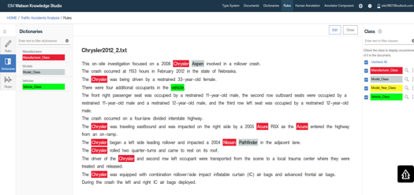

WKS custom models deployed to NLU and WDS, and exported to WEX
WKS is available on IBM Cloud
Build, test, manage, and deploy custom annotators for domain adaptation
Use (run) custom annotators for domain adaptation
Watson Knowledge Studio
Watson Explorer
Notes:
WKS deploys custom models directly to NLU, WDS, and AlchemyLanguage.
WKS custom models also can be exported for manual importing into the WEX NLP pipeline (UIMA).

Slide 20
Watson AI Platform Offerings: Foundational Services
© 2018 IBM Corporation

Slide 21
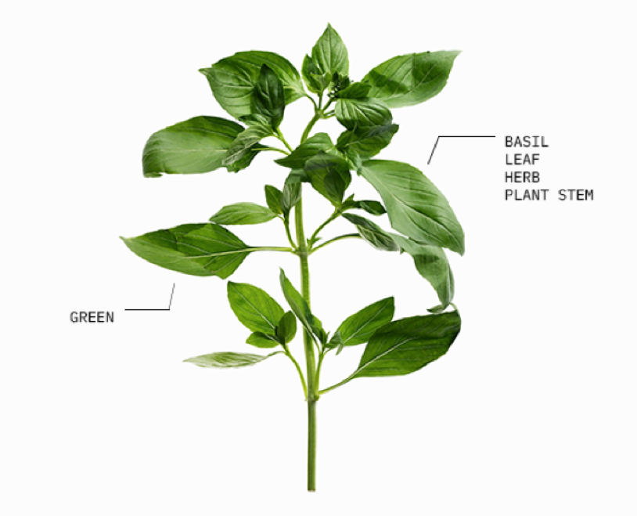
Watson Visual Recognition
An image recognition service that enables users to quickly and accurately tag, classify, and train visual content using machine learning.
© 2018 IBM Corporation

Slide 22

Key Capabilities of Watson Visual Recognition
Tooling
Flexibility and Customizability
Not a developer? No problem! Our tooling allows anyone to get started immediately using your own API key.
Whether you’re looking to get started right away with IBM’s models or custom train your own, we offer options for every user.
Privacy and Security
Simplified query language
IBM ensures that images and data passed through our services remain secure. Your data is never used to train IBM models.
Our API service and best practices guides. make it easy to get started with your preferred language.
Integrated with Watson Studio
Watson Studio is the environment to build, train and deploy Machine & Deep Learning models
© 2018 IBM Corporation

Slide 23

Speech-to-Text
Speech Recognition engine that combines information about grammar and language structure with knowledge of composition of audio signal to transcribe customer care calls, meetings, conference calls; voice control of apps & devices.
© 2018 IBM Corporation
Notes:
applications include voice control of applications, embedded devices, and vehicle accessories; transcribing meetings and conference calls; and dictating email messages and notes.

Slide 24
Features
Keyword Spotting
Identify spoken phrases from the audio that match specified keyword strings.
Custom Models
Language and Acoustic model customization expands domain accuracy.
Mobile Data Collection App
Beta - Customize speech models based on the language of your business application.
Detect Multiple Speakers
Labels each speaker's contributions to a multi-participant conversation
Profanity Filtering
Censor profanity from US English transcriptions by default.
© 2018 IBM Corporation
Notes:
applications include voice control of applications, embedded devices, and vehicle accessories; transcribing meetings and conference calls; and dictating email messages and notes.

Slide 25

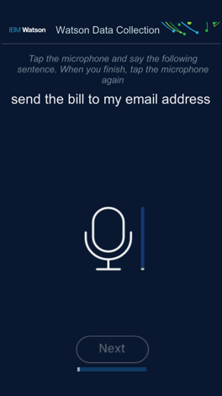
Mobile Speech Data Collection App
Major Features
Mobile app – Available in iOS and Android store for anyone
Run multiple data collection instances with one app
Collect audio data for any language
Customers using to collect data for their use case with their employees
© 2018 IBM Corporation
Notes:
Add link to bluemix page before submitting

Slide 26
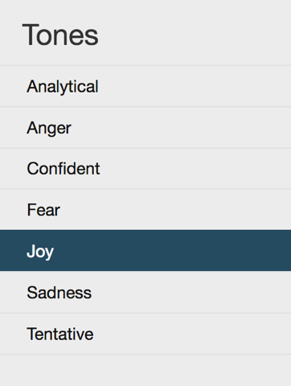
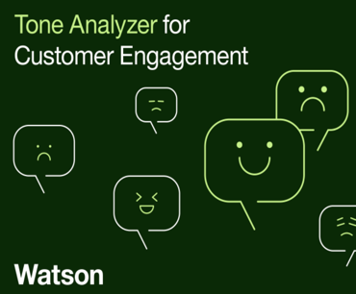
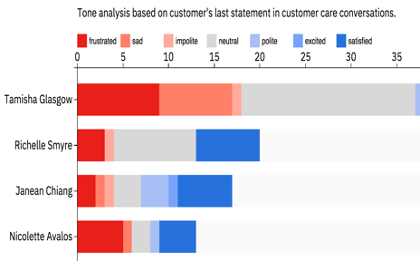


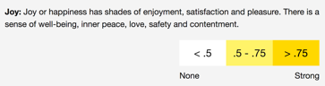
Watson Tone Analyzer Understand tone, style and emotional state
Measure Agent Performance
Analyze Sentence Level Text
Engage Call Center Customers
© 2018 IBM Corporation
Notes:
https://www.ibm.com/watson/services/tone-analyzer/

Slide 27

Watson Language Translator
What language barrier?
Access global markets with ease. Identify, translate, and customize all in a secure environment.
Hello
Bonjour
こんにちは
안녕하세요
Hola
© 2018 IBM Corporation

Slide 28
Features and Differentiators
Language Support
Use 34 language pairs supporting neural machine translation
Data Privacy
Security
Native Translation Accuracy:
Customization (Customized Model)
Document & Website Translation
Corpus Customization
Customize your translation models to best suit your industry
Neural Machine Translation (Q1)
Translate and train with higher accuracy and in less time
© 2018 IBM Corporation
Notes:
Data Privacy: Google and Microsoft’s agreements will need evaluation by legal teams for ownership and data mining.
Security: All Watson Services are officially ISO27001, ISO27017 and ISO27018 certified. This allows IBM to offer better security standards for all their offerings in all deployment models (Standard, Premium & Dedicated). Furthermore, LT has end to end encryption also available in all deployment models. Compute isolation is available in Premium versions of the offering.
Native Translation Accuracy: Though Microsoft and Google offer translations for Word, phrases and sentences, Watson’s accuracy on Sentences is much higher than other two vendors
Customization (Customized Model): Microsoft natively does not offer customizations for their machine learning models and allows customizations only for the statistical machine translation models which are not as proficient. Furthermore, for parallel customization you need about 200,000 words in source and target languages for a good model. With IBM LT, you can do both types of customization on the neural machine models. Relying on forced glossary is effective for quick results whereas parallel customization helps fluency.
Document & Website Translation: Allow enterprises to translate MS Office files (ppt, word, excel) while preserving format. i.e. You can translate an entire PowerPoint and preserve all formatting. IBM will also release a beta feature that translates pdf to docx and preserves. Later, we will release a pdf to pdf translation as well. From our analysis no other vendor in the market does this today.

Slide 29


Natural Language Classifier Data is yours to classify
Customize
Secure
Scale
Create custom classifiers to sort data into categories
Secure enterprise data with the IBM Cloud
Classify social, support, legal, email data at scale
© 2018 IBM Corporation

Slide 30
Features
Classify Multiple Text Phrases
Classify multiple items with a single API call
DLaaS – Deep Learning as a Service
Train data at faster speeds and in larger quantities (20k) with GPUs.
Multi-Intent Classification
Extract multiple intents from text
Chain Multiple Classifiers
Separate text at classify at multiple levels
© 2018 IBM Corporation
Notes:
Best Practices guide - https://www.ibm.com/watson/assets-watson/pdf/Watson-NLC-Links-Best-Practices-Design-Patterns.pdf

Slide 31
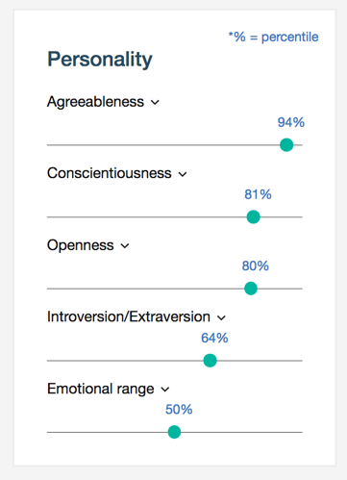
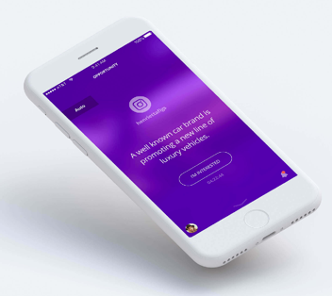
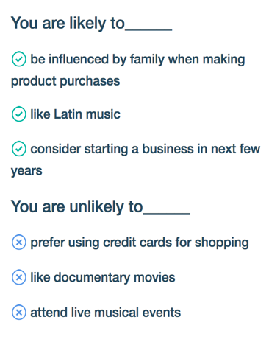
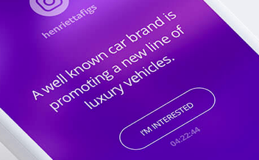
Watson Personality Insights Insights from social media, enterprise data & other digital communications
Develop Detailed personality portraits
Understand Consumption preferences
Tailor Customer experience
© 2018 IBM Corporation

Slide 32

© 2018 IBM Corporation

